Slide 1
Transfer of Learning
Name
Course
Date

Slide 2
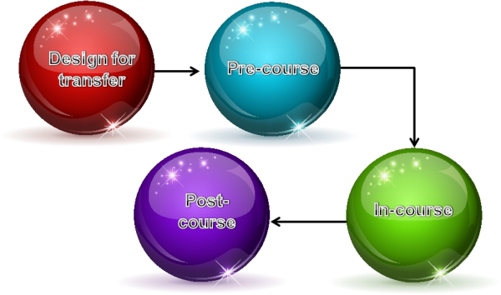
Introduction
Transfer of learning refers to the way workers are able to apply their learning in the training sessions to actual workplace and hence bring in effectiveness.

Slide 3
Introduction
Transfer of learning occurs when the learner;
Recognizes common features among concepts, skills, or principles
Links the information in memory
Sees the value of utilizing what was learned in one situation in another

Slide 4
Concepts and Theories of Transfer of Learning
Theory of identical elements- It tends to assume that the training and work environment are the same. The transfer of knowledge and skills should be fairly stable and straightforward. The transfer process is described as “near” since there are no significant differences between the training context and the work context. On-the-job training is an example of a training method that can achieve “near” transfer.
Generalization theory- It tends to assume that there are trained knowledge and skills that can be used in different work situations. For instance, using leadership skills to influence colleagues, peers, your manager or customers might require modifying those trained skills, depending on the relationship and the other person’s behavior. This type of transfer is considered “far” because the correct steps to apply the trained skill may not be uniformly applied across situations, hence requiring the trainee to generalize the training to other situations.

Slide 5
Concepts and Theories of Transfer of Learning (cont’)
The cognitive theory-It focuses on the inside processes which help learners maintain as well as recall knowledge learned together with apply it in a workplace setting. Since it can be applied in diverse situations, it is significant to both near and far transfer. An excellent example of the application of the cognitive theory is using goal setting at the last part of a training program. Goal setting assist learners to focus on a definite as well as challenging goal to apply their familiarity and skills in the work setting

Slide 6
Sphere of influence
The culture of the organization offers a significant environment for the transfer of learning to be effected.
Skill development together with self management assist employees to develop personally as well as professionally.
Learning organizations are those which encourage transfer of learning.

Slide 7
Sphere of influence (Cont’)
It enables employees to understand the significance of performing work in alignment with vision.
Enables employees to suggest for product development together with new ideas
Transfer of learning helps in cementing the idea of constant development.

Slide 8
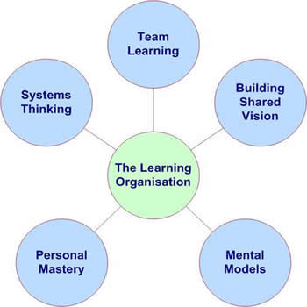
5 components of a learning organization
Building shared Vision- It gives an exact sense of purpose and it is significant since it offers the focus and energy for learning.

Slide 9
5 components of a learning organization (Cont’)
Team Learning- It is the process of aligning as well as developing the ability of a team to fashion the results its members actually desire. Individuals require each other to realize their purpose. Teams are the main learning group of organizations. Talented teams are made up of talented people. Team Learning is the building block for organizational learning.
System thinking- It enables one to focus on patterns as well as interrelationships and it also involves the adoption of a holistic strategy to problem solving without having to look at personal blame games. This component involves an individual ability to see the association between issues as well as events together with information as a whole. Its focus is to try to understand the way significant factors interact in a collective way to produce the problem

Slide 10
5 components of a learning organization (Cont’)
Personal Mastery- Lack of personal mastery makes people and the organization not to continue leaning. Leaders learn to use tools such as Perceptual Positions and Reframing so as to enhance the quality of interaction together with relationship in and outside their teams.
Mental models- With mental models, leaders learn to use tools such as the Ladder of Inference and Reflective Inquiry so as to practice making their mental models clearer for each other and challenging each other’s assumptions so as to construct shared understanding

Slide 11
References
Argyris, C., & Schön, D. (1996). Organizational learning II (1st ed.). Reading (Mass.): Addison-Wesley.
Shrivastava, T. 6 Important Theories of Transfer of Learning. Retrieved from http://www.psychologydiscussion.net/educational-psychology/6-important-theories-of-transfer-of-learning/1827

